Slide 1
Introducing the
Vision and Mission Principles
- Conversation ideas for gathered communities

Slide 2
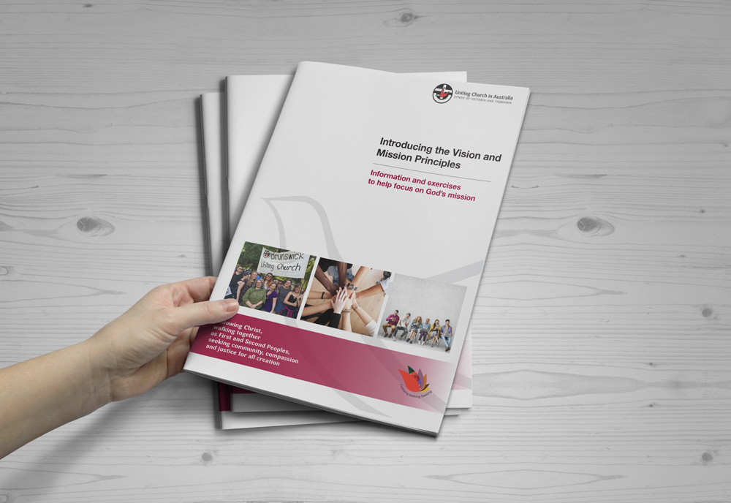
As you read Introducing the Vision and Mission Principles, the questions, quotes and activities on the following pages may
help shape your
conversations

Slide 3
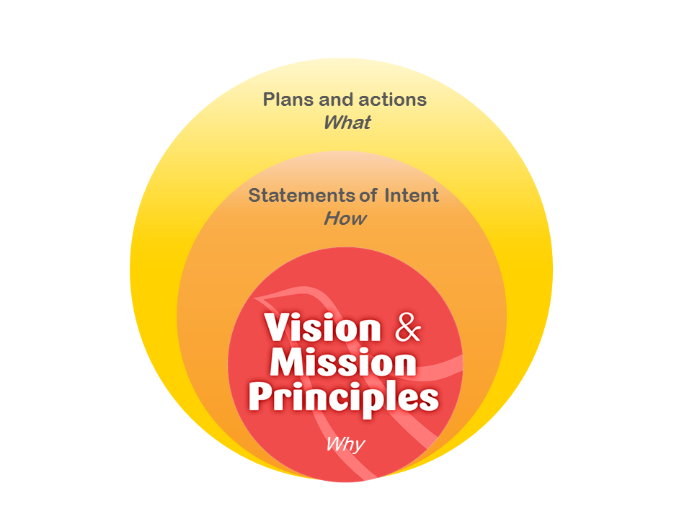
A call for openness to the renewing work of God’s Spirit in our life as a Church

Slide 4
Reflection: a calling of the Spirit

Slide 5
Our Vision…
‘Our Vision Statement articulates the passion and desire for the future direction of the Synod expressed by people across the Church in Victoria and Tasmania. It is a statement of who we are …. It is the story we are living as a pilgrim people on our way’.
MSR report to the June 2016 Synod
After completing this reflection, follow the process of personal and group reflection on Page 9 of the booklet resource

Slide 6
Ideas for going further with the Vision
Following
Walking
Seeking

Slide 7
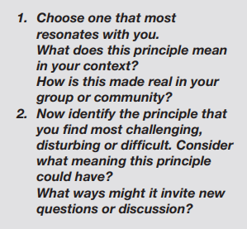
Our seven Mission Principles

Slide 8
Which of the surrounding quotes spark conversation about mission for you?
Which of the surrounding quotes spark conversation about mission for you?
‘Mission describes the very nature of the Christian life in all its communal, liturgical, institutional, spiritual and service dimensions’.
‘It is proper that God’s Church work in partnership with all people of good will to fulfil God’s purposes’.
‘Mission is not optional or secondary to the Christian community, but is at the heart of its calling in the power of the Spirit to follow Christ’.
‘The Church must always be looking to listen to each generation and culture so as to live out the Gospel in fresh ways’.
‘The life of the church community is a witness to reconciliation as barriers are overcome and all find a place at God’s table’.
‘In following the witness of the First Peoples, the Church is called to care for God’s creation’.
‘This is the nature of Christian maturity, the following of Jesus Christ to those marginalised and oppressed’.

Slide 9
Discerning our way as God’s people
‘Seeking to discern the Spirit is an ongoing task in our changing world’.
‘Discerning the Work of the Holy Spirit’
Assembly Doctrine Working Group, 2011

Slide 10
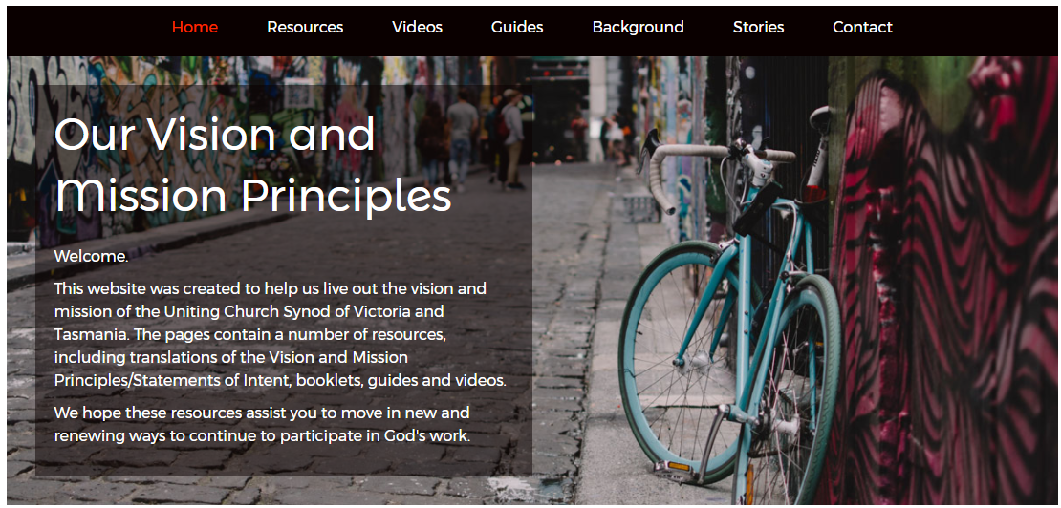
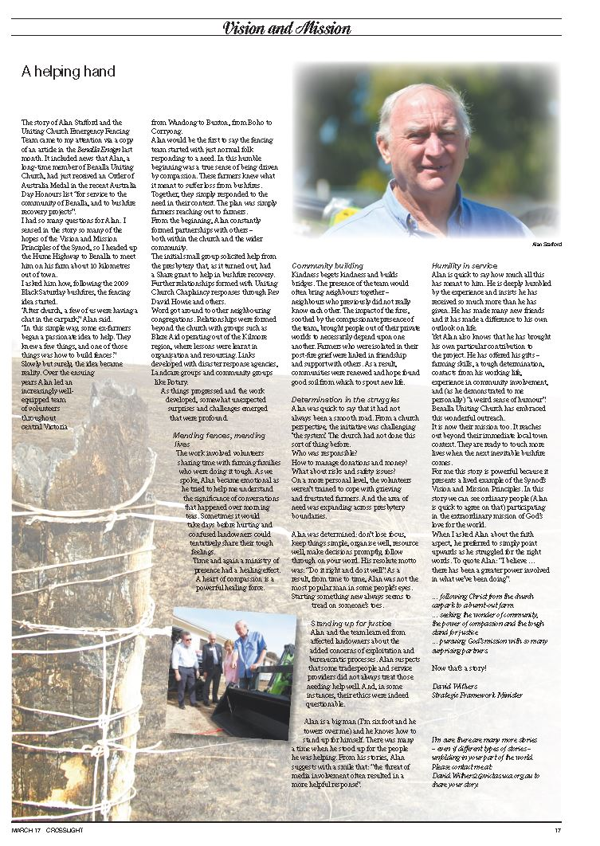
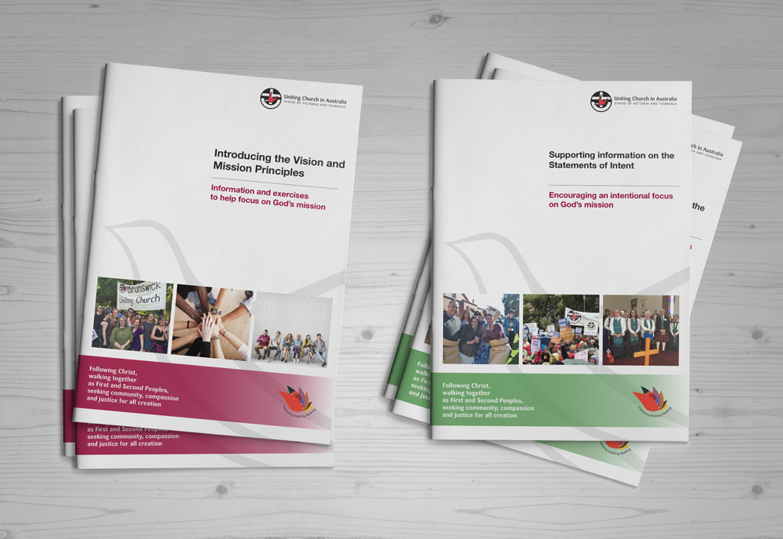
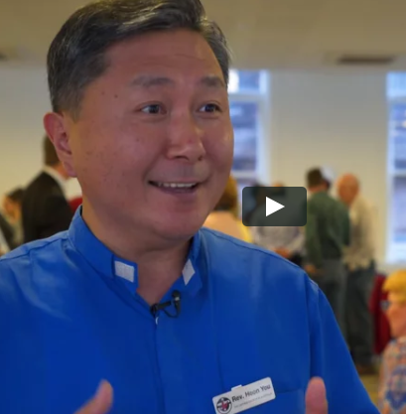
Looking for more tools to assist conversations? Visit http://ucavictas.org.au/visionandmission/ for downloadable resources

