Slide 1
The Statements of Intent
Ideas and actions to help explore
the Statements in your own context

Slide 2
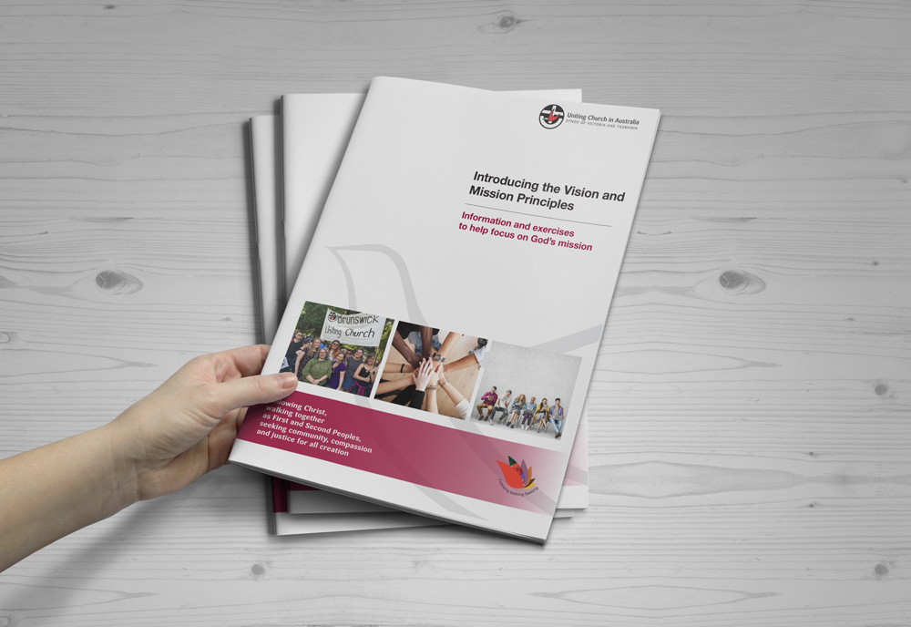
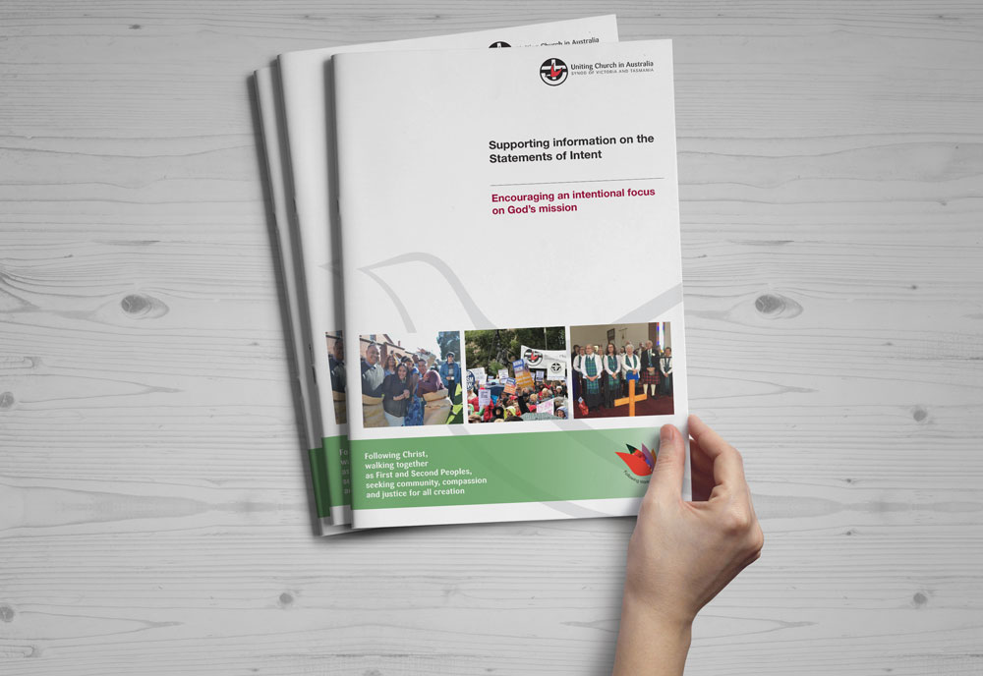
You may have previously read
Introducing the Vision and Mission Principles,
a booklet exploring the Vision and Mission Principles of the Synod.
These slides are designed to guide groups working through the second booklet in the series,
Supporting Information on the Statements of Intent.

Slide 3
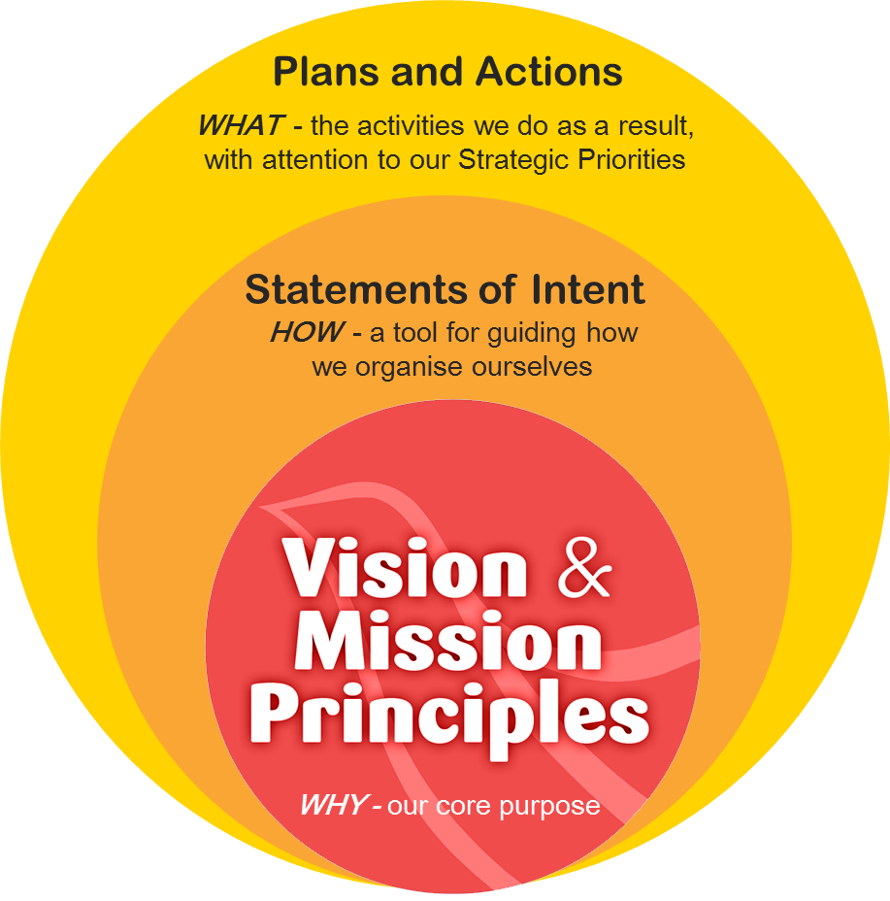
The Statements of Intent seek to encourage a way of travelling together as God’s people, building a vibrant church.

Slide 4
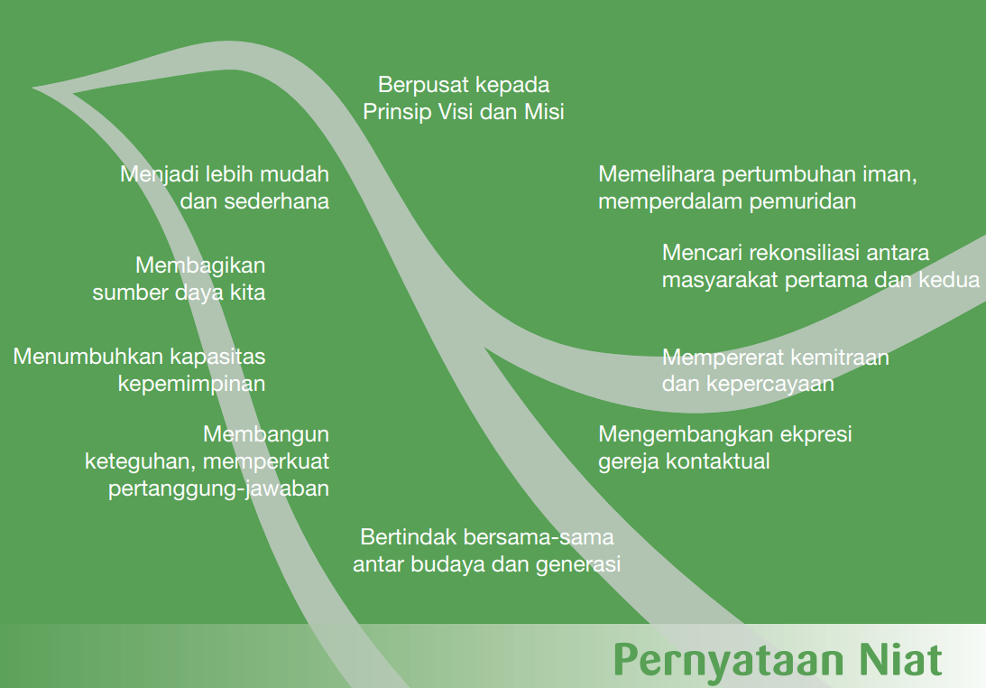
The 10 Statements of Intent

Slide 5
What is the purpose of
the 10 Statements of Intent?
The Statements of Intent were developed as a tool to guide ‘how’ we strengthen our focus on God’s mission in a changing world.
Each Statement responds to issues and challenges identified in the life of the Church.
The Statements of Intent inform how we shape and encourage a vibrant Church for the 21st century.

Slide 6
Let’s start by looking at all ten Statements of Intent together
Have Page 3 of the resource booklet open or a copy of the 10 Statements to help with this exercise.
Begin by reading the 10 Statements of Intent and then read D’Arcy Wood’s quotation.
Take some personal time to consider these 3 questions…

Slide 7
Let’s go through the Statements of Intent one at a time OR you may choose to select particular Statements to focus on.
Focus on Vision and Mission Principles (pp. 6-7)
We will focus proactively and strategically on engaging in effective and relational mission.
This Statement invites an ongoing conversation between
the life and witness of each community and the broader
statements of purpose offered by the Vision and Mission Principles.
It reflects the intention to maintain our focus on the ‘why’ of the Church’s life.
Remember that this booklet may be helpful

Slide 8
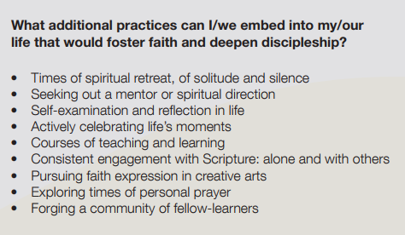
Foster faith, deepen discipleship (pp. 8-9)
We will support and inspire people of all ages to come to faith and to grow in their faith, stimulating interest in Christ and his way in the wider community.
Can we seek new and renewing participation in God’s mission as Church if we are not equally seeking such renewal in ourselves and our own community?

Slide 9
Seek reconciliation between
First and Second Peoples (pp. 10-11)
We will actively pursue a better way in our shared relationships between First and Second Peoples, as modelled to us by Christ’s covenant. We will work in solidarity with the Uniting Aboriginal and Island Christian Congress for God’s justice and righteousness in this land.
Considering the extract below from 2 Corinthians and the comments on page 11, how can this be ‘brought to life’ through your personal, group or larger community efforts?
What is the place of grace, humility, lament and loving action in possible responses?
2 Corinthians 5:16-21 New Revised Standard Version (NRSV)
16 From now on, therefore, we regard no one from a human point of view; even though we once knew Christ from a human point of view, we know him no longer in that way. 17 So if anyone is in Christ, there is a new creation: everything old has passed away; see, everything has become new! 18 All this is from God, who reconciled us to God’s self through Christ, and has given us the ministry of reconciliation;
19 that is, in Christ God was reconciling the world to God’s self, not counting their trespasses against them, and entrusting the message of reconciliation to us. 20 So we are ambassadors for Christ, since God is making God’s appeal through us; we entreat you on behalf of Christ, be reconciled to God. 21 For our sake God made him to be sin who knew no sin, so that in him we might become the righteousness of God.

Slide 10
Deepen partnerships and trust (pp. 12-13)
We will develop a more cohesive culture of trust, partnership and support.

Slide 11
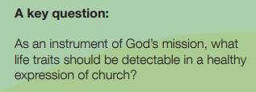
Nourish contextual expressions of church (pp. 14-15)
We will recognise and nourish the diversity of forms in which we gather as communities of faithful people.

Slide 12
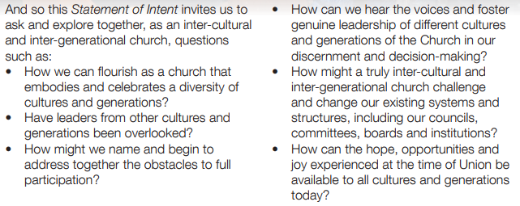
Act together across cultures
and generations (pp. 16-17)
We will develop and deepen our relationships to be, in practice,
an inter-cultural, inter-generational church.
The gifts of time and listening - respectfully seek out an opportunity to sit with a person of another generation or not of your cultural background. Ask how they experience life in the Uniting Church.

Slide 13
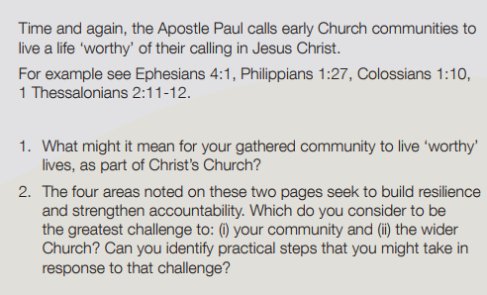
Build resilience, strengthen accountability (pp.18-19)
We will act with faithful integrity by way of mutual accountability, wise stewardship and good governance.

Slide 14
Grow leadership capacity (pp.20-21)
We will grow the capacity of all forms of leadership
in the current and future Church.
Take time in your gathered community to explore three possible areas of response (note p.21 dot points) for growing leadership capacity:
Provide ongoing support to our current leadership.
Identify the emerging leaders in our gathered community.
Explore everyone’s leadership in daily life.

Slide 15
Share our resources (pp.22-23)
We will be more strategic in the organisation and sharing of all resources
– our people, property and finances – for the common good.

Slide 16
Be lighter and simpler (pp.24-25)
We will be lighter and simpler in our practices and formal structures so we can be more flexible and proactive in responding to the movement of the Spirit.

Slide 17
Your feedback, ideas and/or comments are important.
In what ways have the Statements of Intent, and the discussions within your gathered community, affirmed, challenged or renewed ‘how’ your community is journeying together as God’s people in our Synod?
What stories are emerging that reflect the hope of one or more of these statements?
Do you have experiences that you would be willing to share with the wider church?
If you would like to, please forward any thoughts or images to
Email: strategic.reviewimplementation@victas.uca.org.au

Slide 18
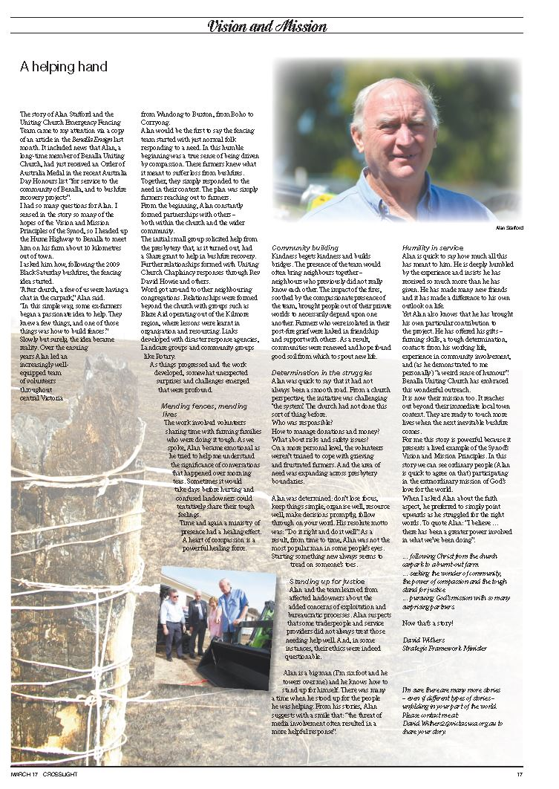
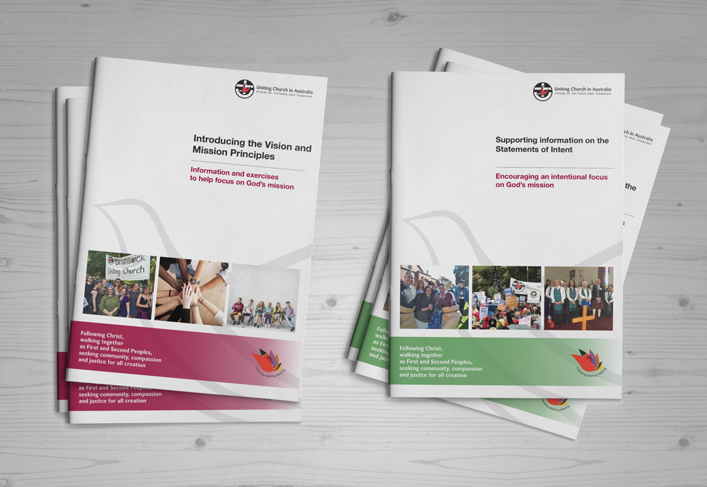
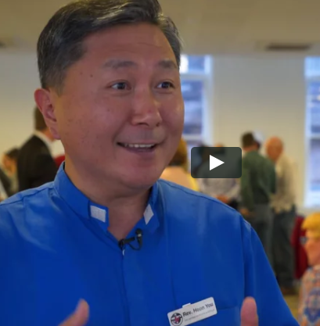
Looking for more tools to assist conversations? Visit http://ucavictas.org.au/visionandmission/ for downloadable resources

