Slide 1
Study 6
For all Creation

Slide 4
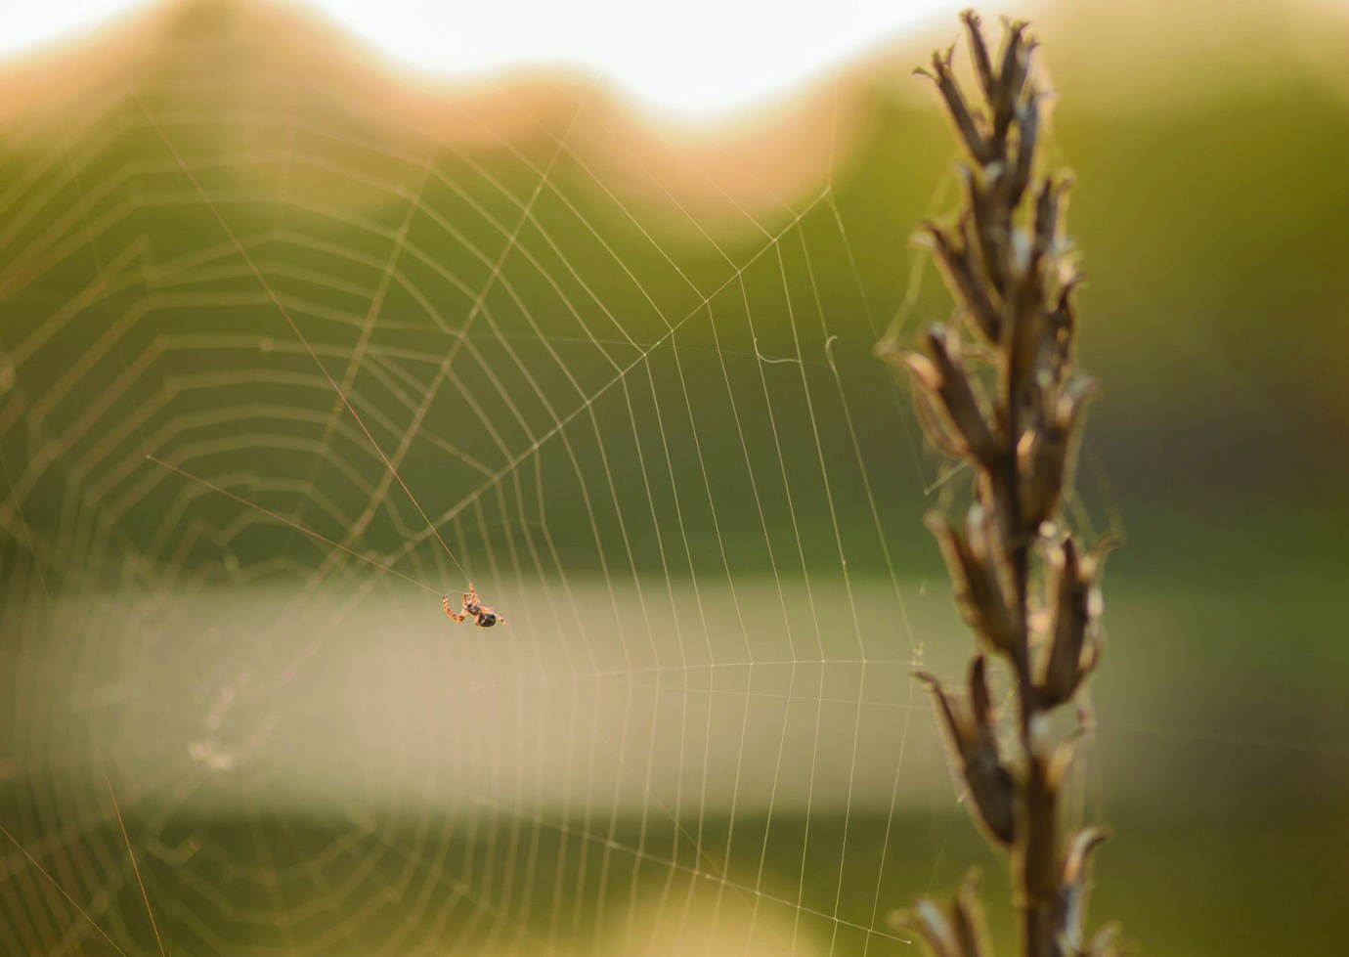

Slide 5
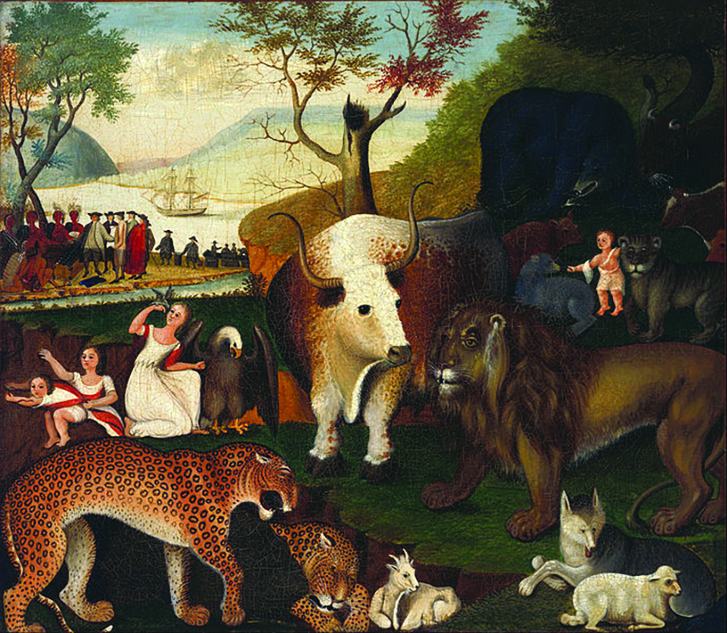
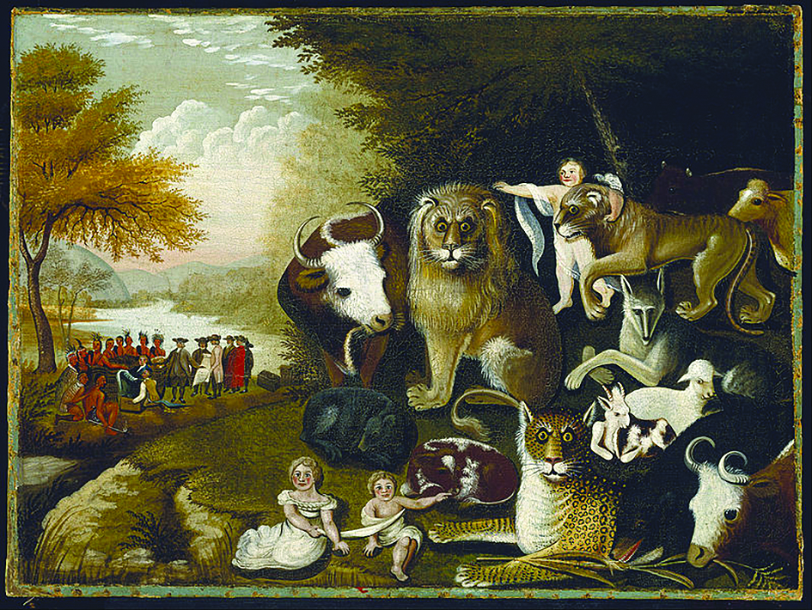

Slide 6
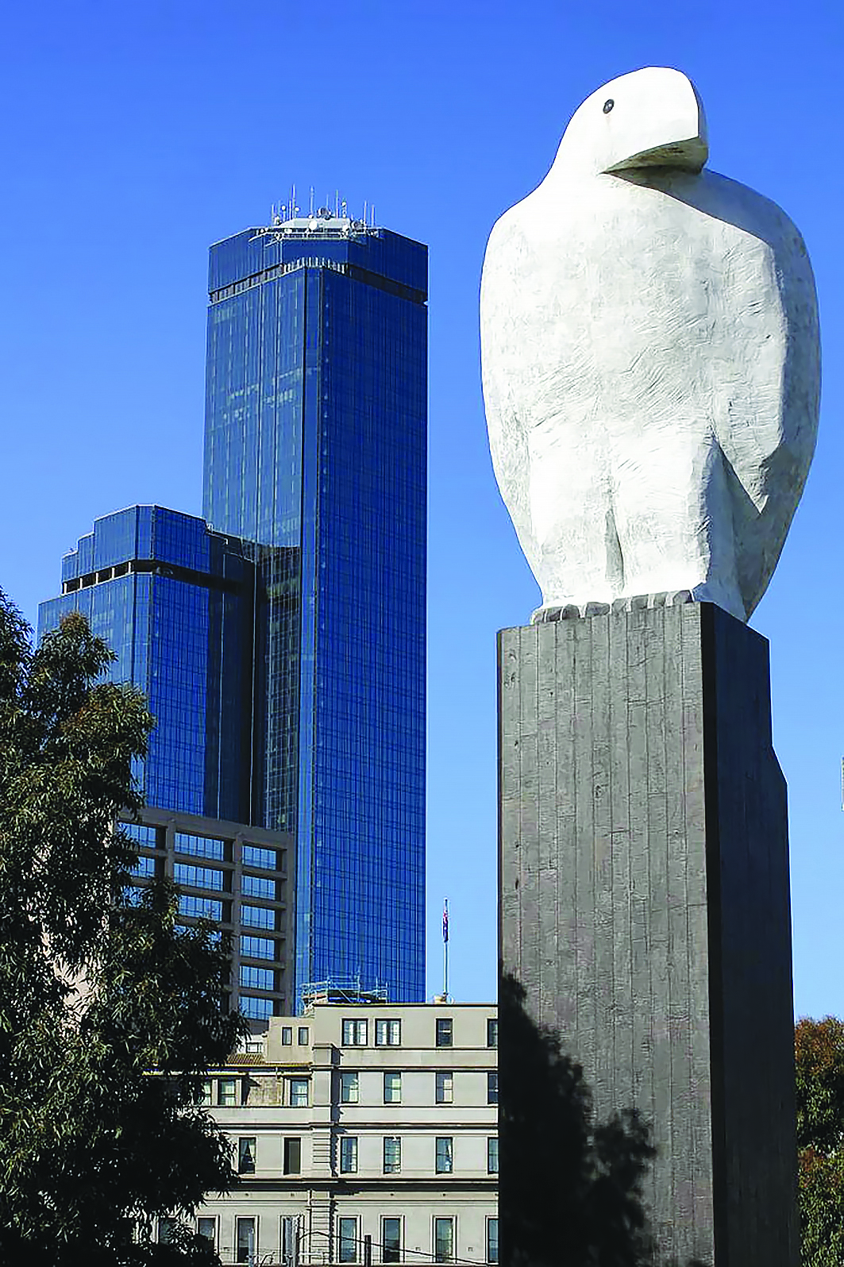

Slide 7
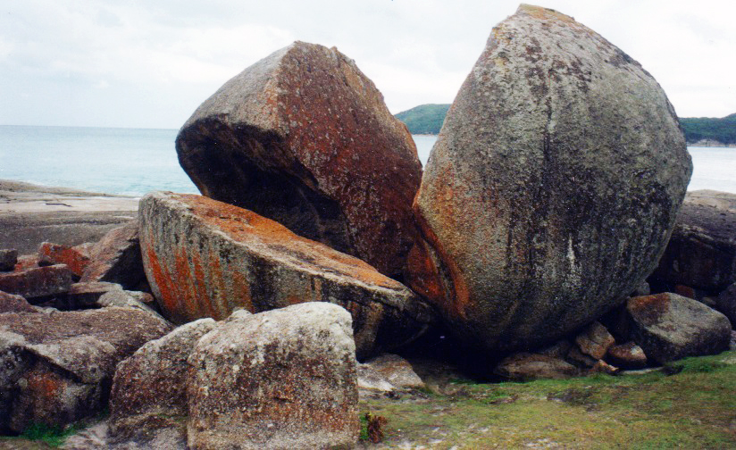
Wilsons Prom, Presbytery of Gippsland, Photographer: Cath James

Slide 8
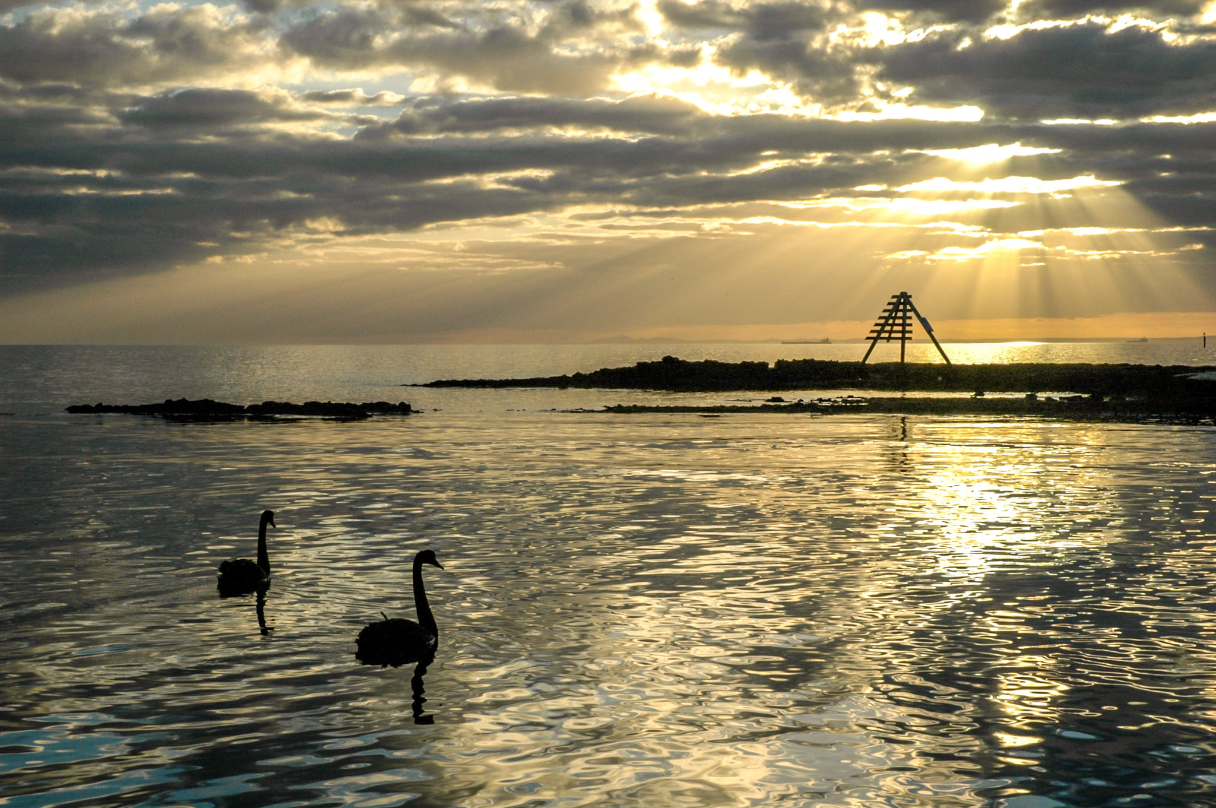
Black Rock, Presbytery of Port Philip East, Photographer: Ian Ferguson

Slide 9
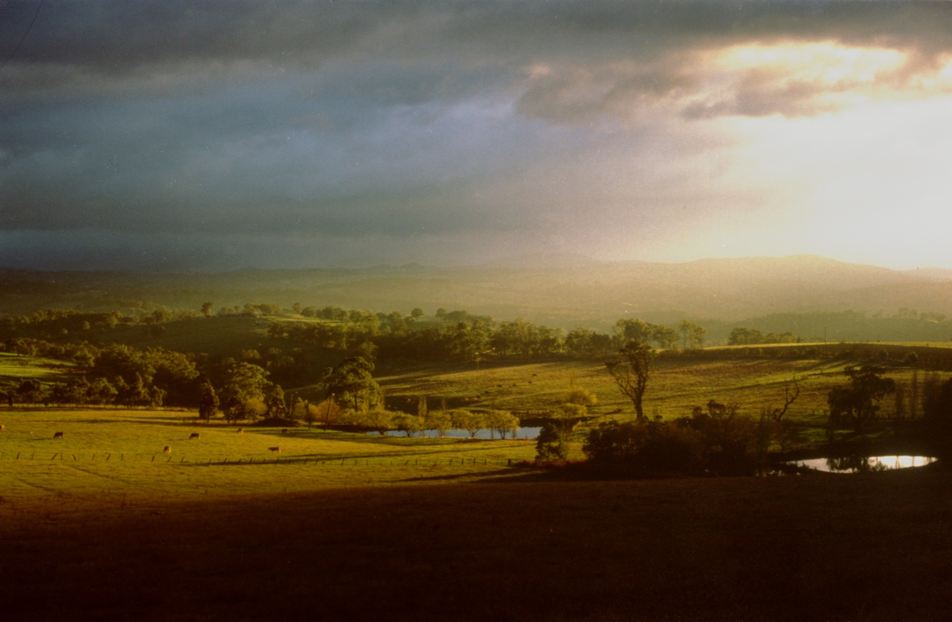
Kangaroo Ground, Yarra Yarra Presbytery, Photographer: Andrew Boyle

Slide 10
Mt Feathertop, Presbytery of North East Victoria, Photographer: Ian Ferguson

Slide 11
Cradle Mountain, Presbytery of Tasmania, Photographer: Paul Chalson

Slide 12
Wind near Warracknabeal, Presbytery of Western Victoria, Photographer: Hoon You

Slide 13
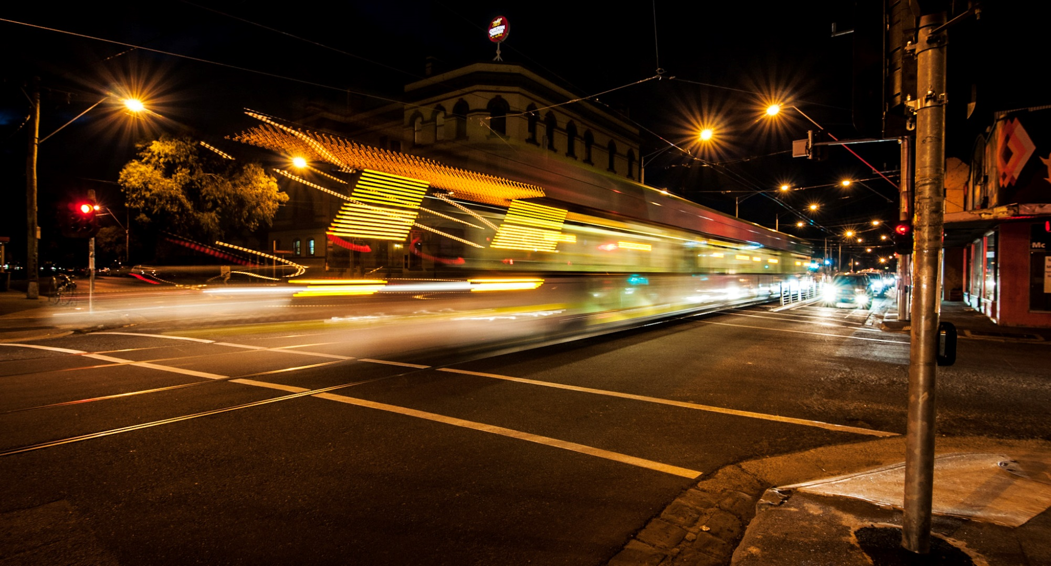
Brunswick, Presbytery of Port Philip West, Photographer: Ian Ferguson

Slide 14
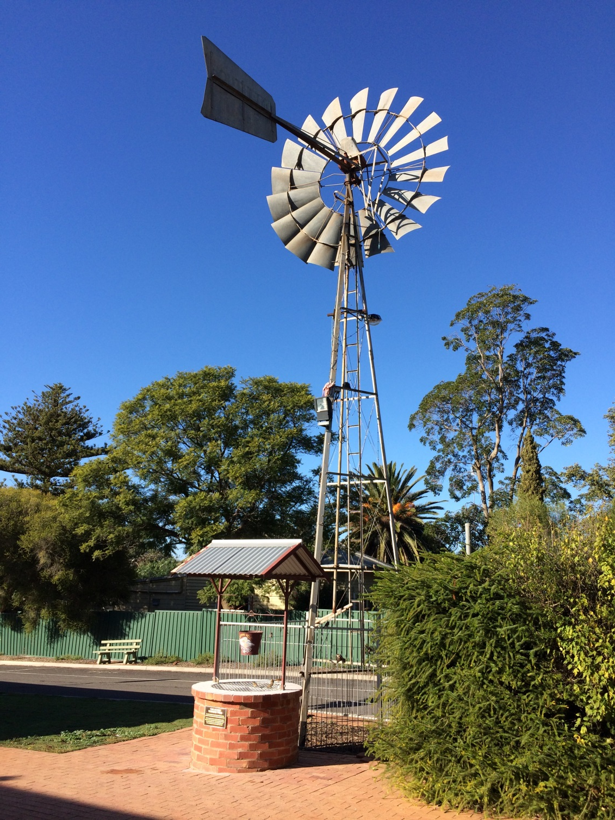
Windmill, Ouyen, Presbytery of Loddon Mallee, Photographer: Cath James

